Slide 1
DATA MANAGEMENT(INT217)
NAME:K HARSHAVARDHAN REDDY
REGNO:11806793

Slide 2
Objectives
The excel sheet contains the data of suicides in various countries from the year 1985 to 2016
Country wise suicides
Year wise suicides
Sex wise suicides per 100k population
Generation wise GDP per capita
Generation wise suicides
Age wise suicides

Slide 3
DASHBOARD:
The Excel Dashboard is used to display overviews of large data tracks
Excel Dashboards use dashboard elements like tables and charts to show the overviews
The dashboard ease the process by showing the vital parts of the data in the same window

Slide 4
Step by Step procedure to create a Dashboard:
Select a data from any website or source which has maximum number of rows and columns
The data from any source may or may not contain errors
Thoroughly check the data
But sometimes it not possible for us to find out all the errors present in the data
At that point of time tableau is very useful and makes your work simple and easy

Slide 5
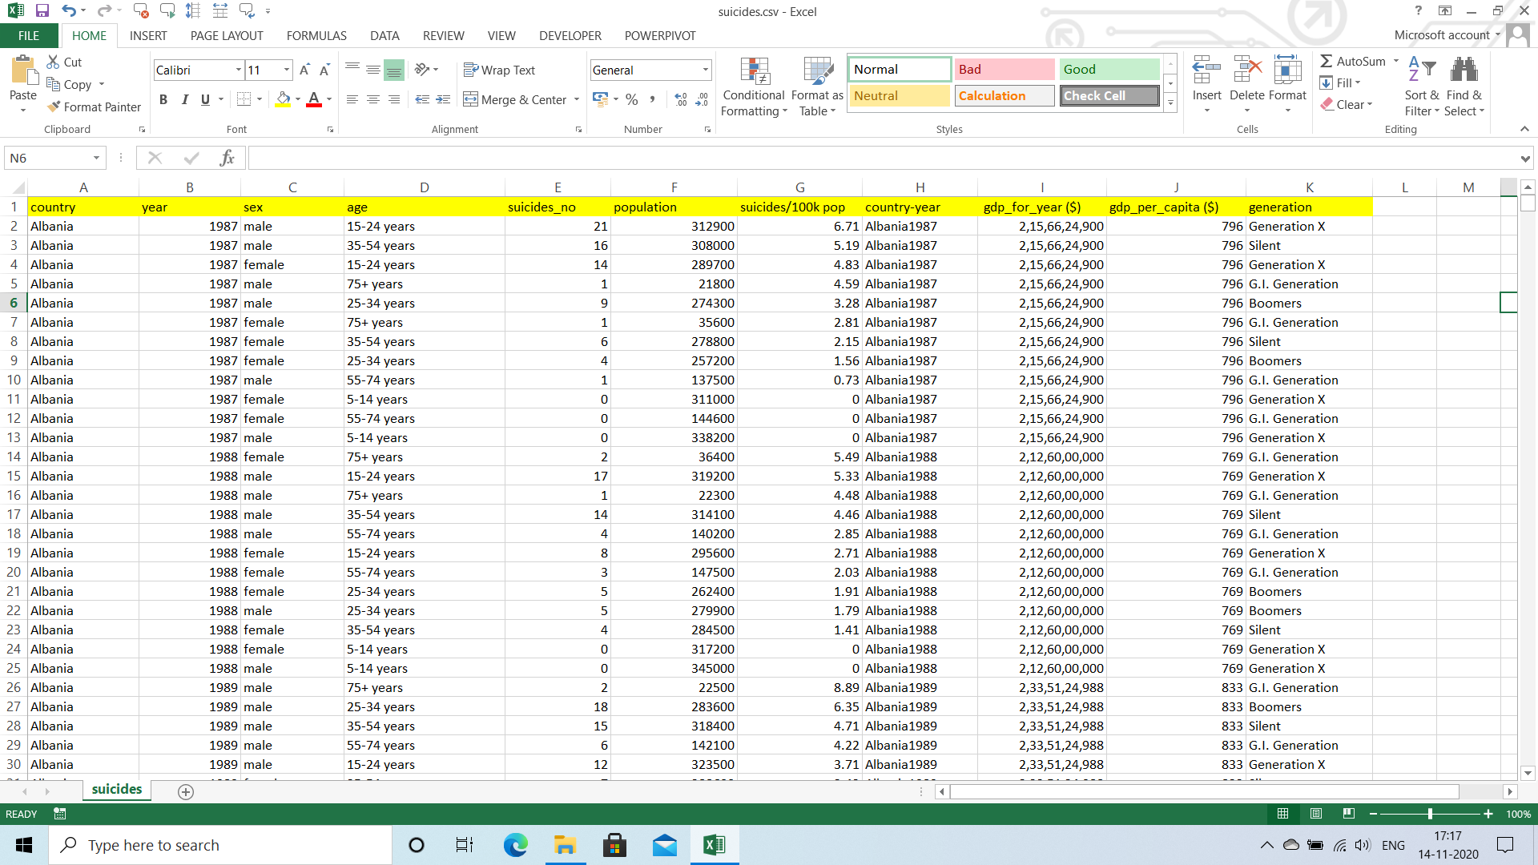

Slide 6
TABLEAU
Tableau prep is a software where you can clean data in a efficient manner
Here Data is imported from different files and changes are done according to the problem
You can observe in the above excel sheet you can find out the column COUNTRYYEAR, it is the combination of country and year column.
It leads to data redundancy so we need to remove this column as well as check the data types
All the cleaning process is done in tableau

Slide 7
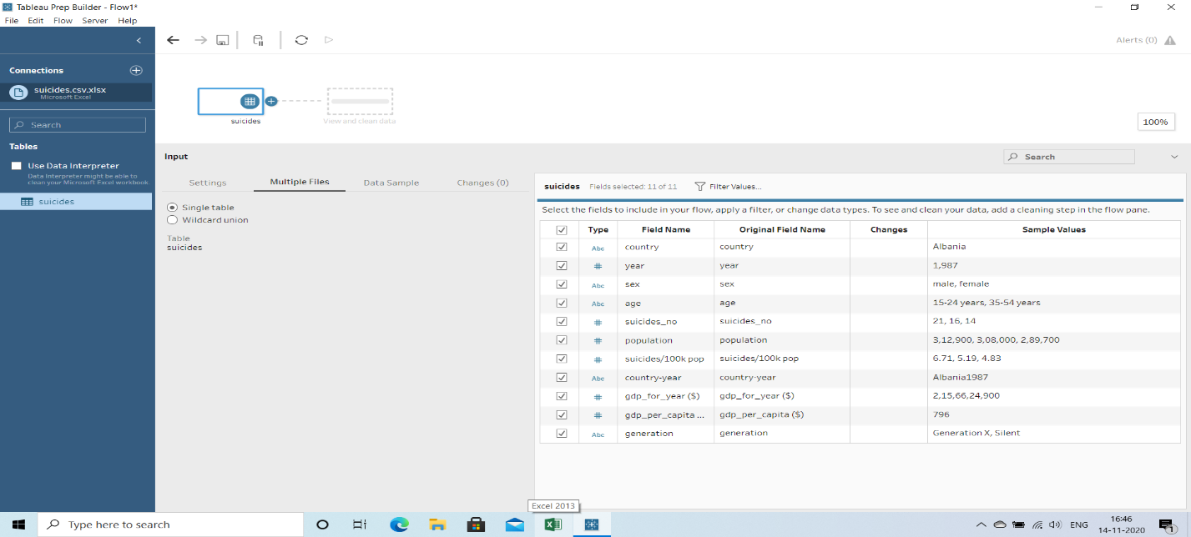
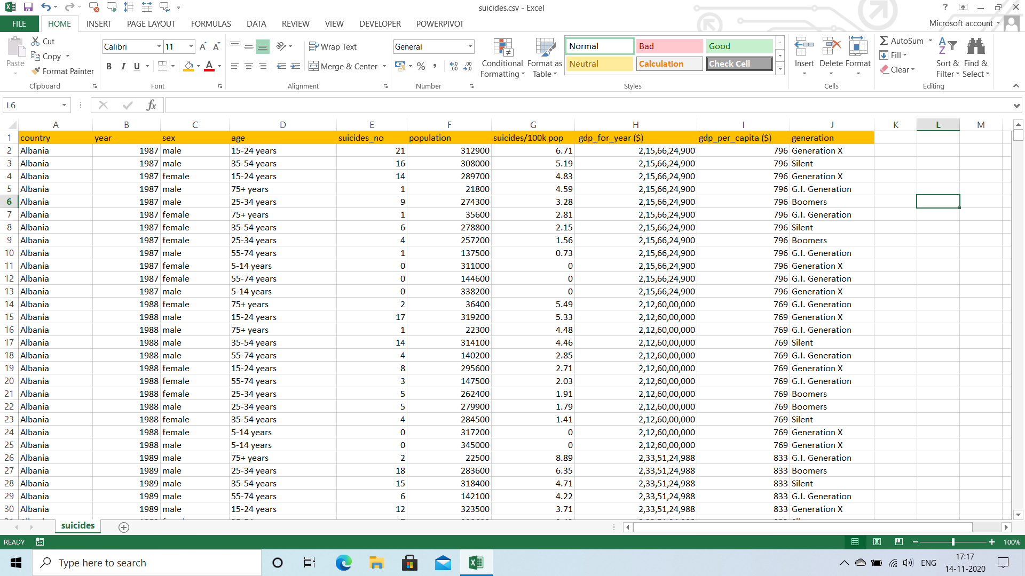
Before performing cleaning operations
After performing cleaning operations

Slide 8
Operations done in tableau
When the data is imported in to tableau check the data types
Perform the changes according to your requirements
You can perform operations by using clean step
After all the cleaning is done ,generate the output and save in the device
Now create Dashboard using this excel sheet

Slide 9
Creating a pivot table
Select the data from the worksheet and go to the option insert
insert -> pivot table -> Create on new work sheet
Now you can create a pivot table by dragging and dropping columns into the required fields
There are four columns in the pivot table
Rows
Columns
Filters
Values

Slide 10
How to create a pivot chart
This step is performed after creating pivot table
Select the pivot table and go to the insert
Insert -> recommended charts ->select any chart
Always insert the pivot chart which are shown in recommended charts for better visualization and understanding
Now you can perform operations related to design part
This makes your pivot chart attractive

Slide 11
How to create a slicer
The process is almost same as creating a pivot table , but there is a slight change here
Select the data in the pivot table
Insert -> slicer -> Select the column which you need as a slicer
Slicer is created and you can visualize the data according to your Objectives

Slide 12
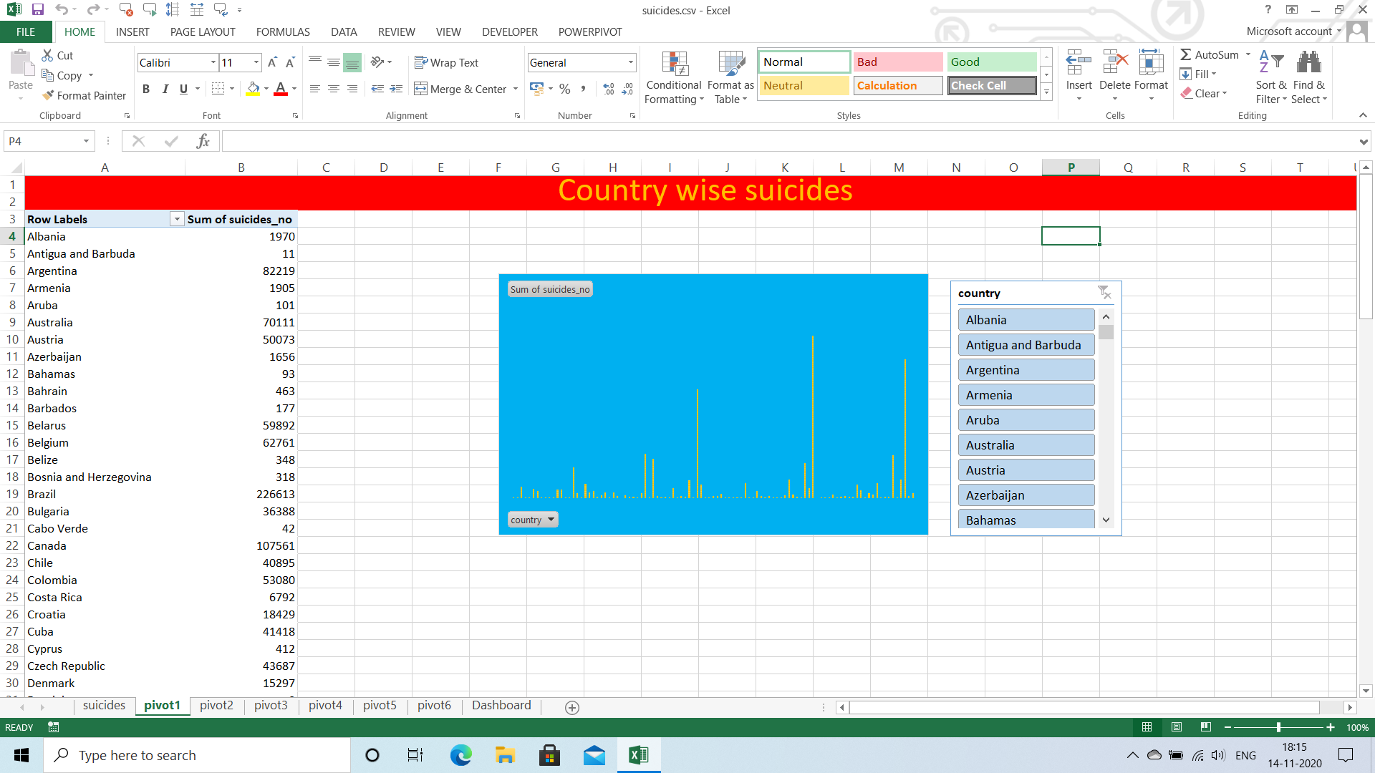
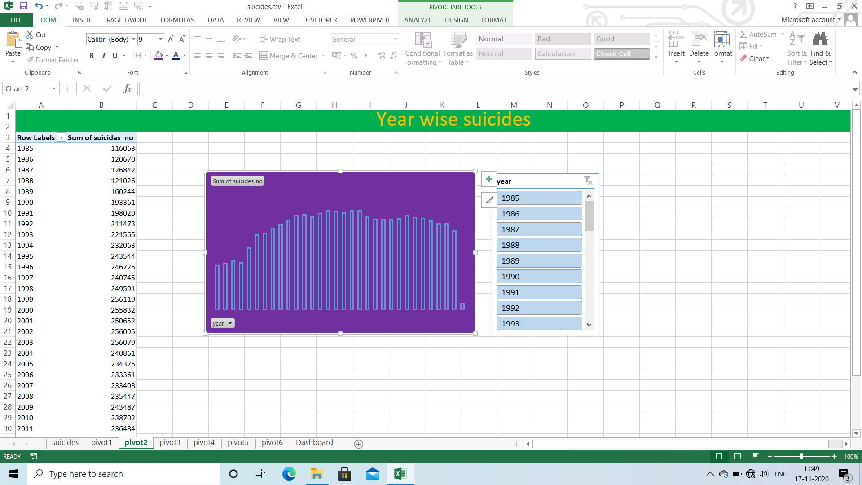
Pivot tables , charts and slicers for objectives

Slide 13
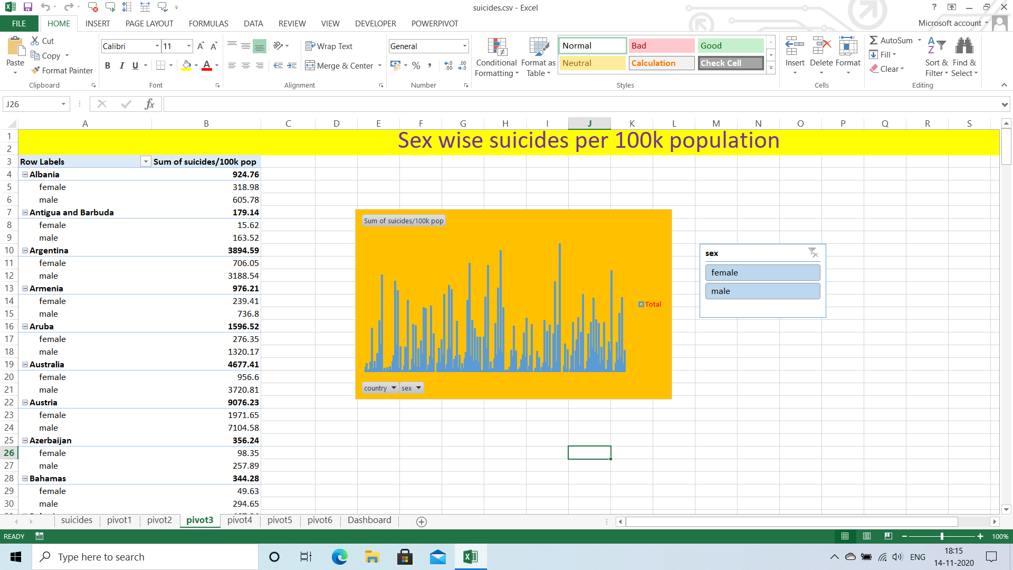
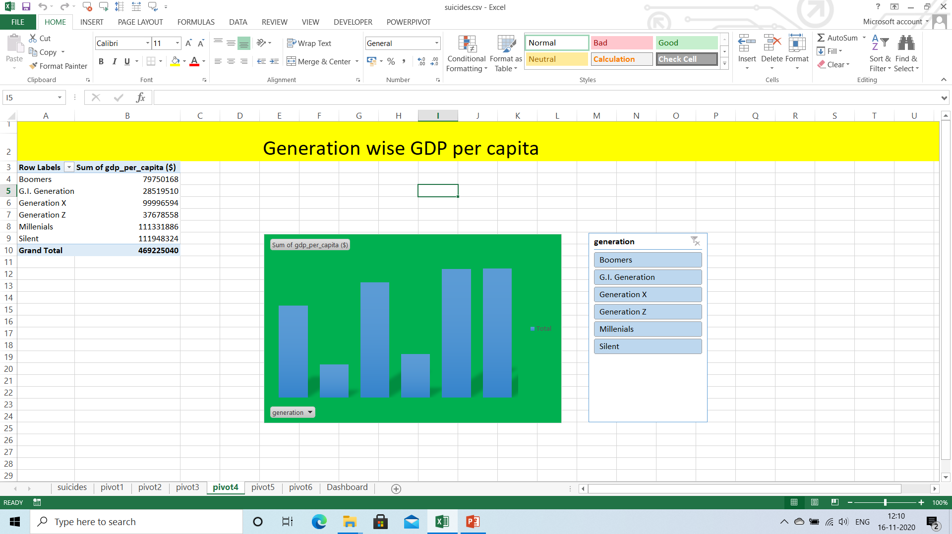
Pivot tables , charts and slicers for objectives

Slide 14
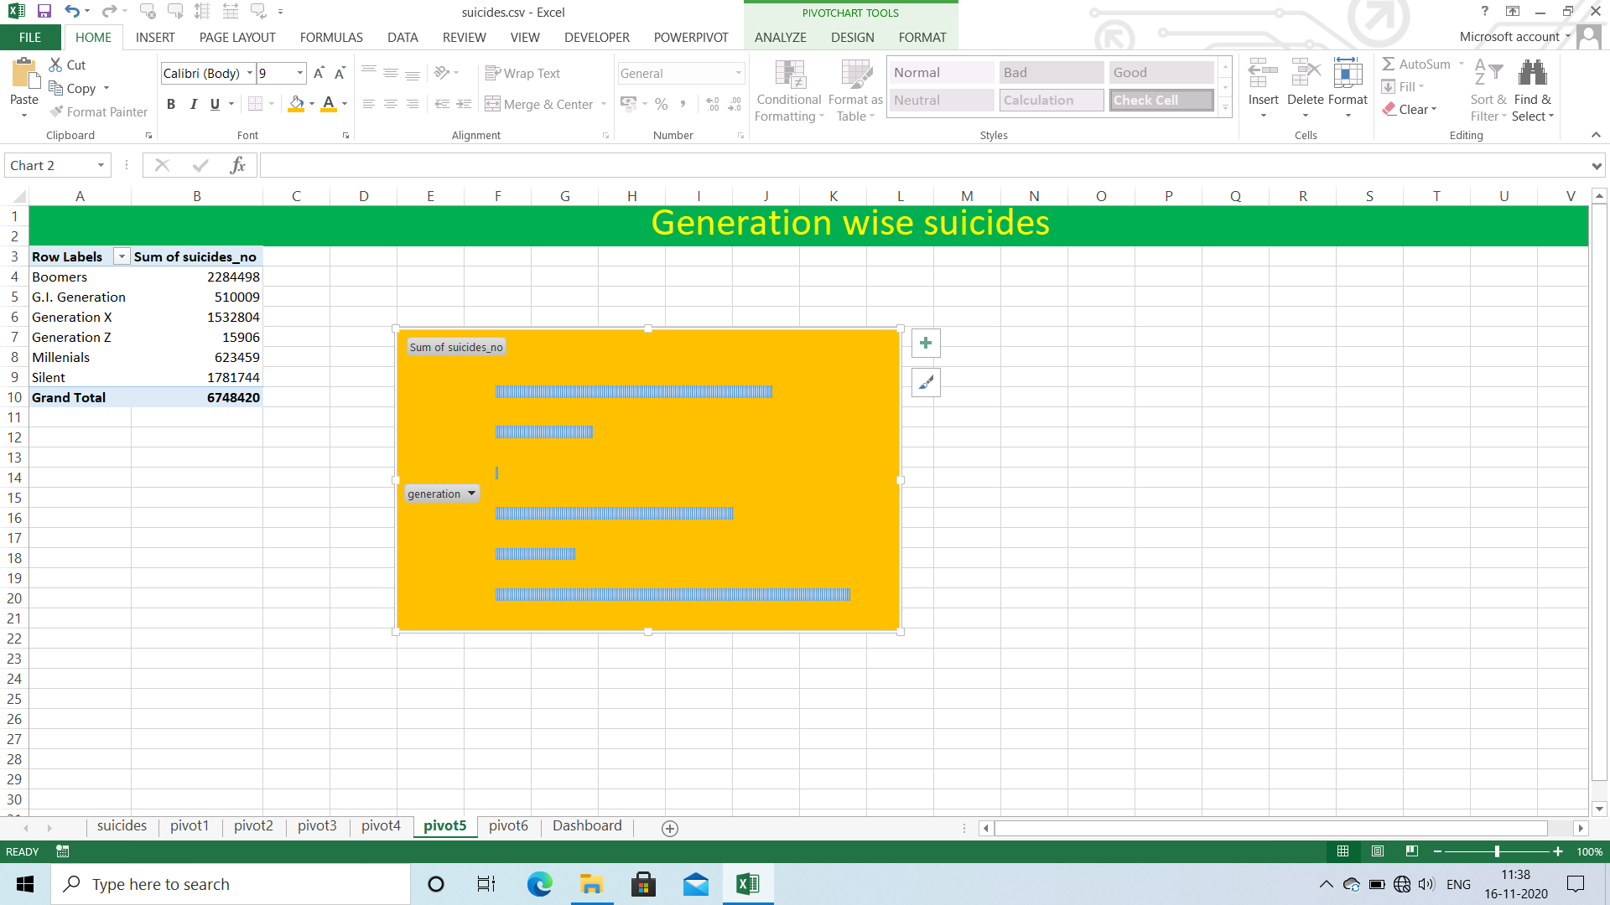
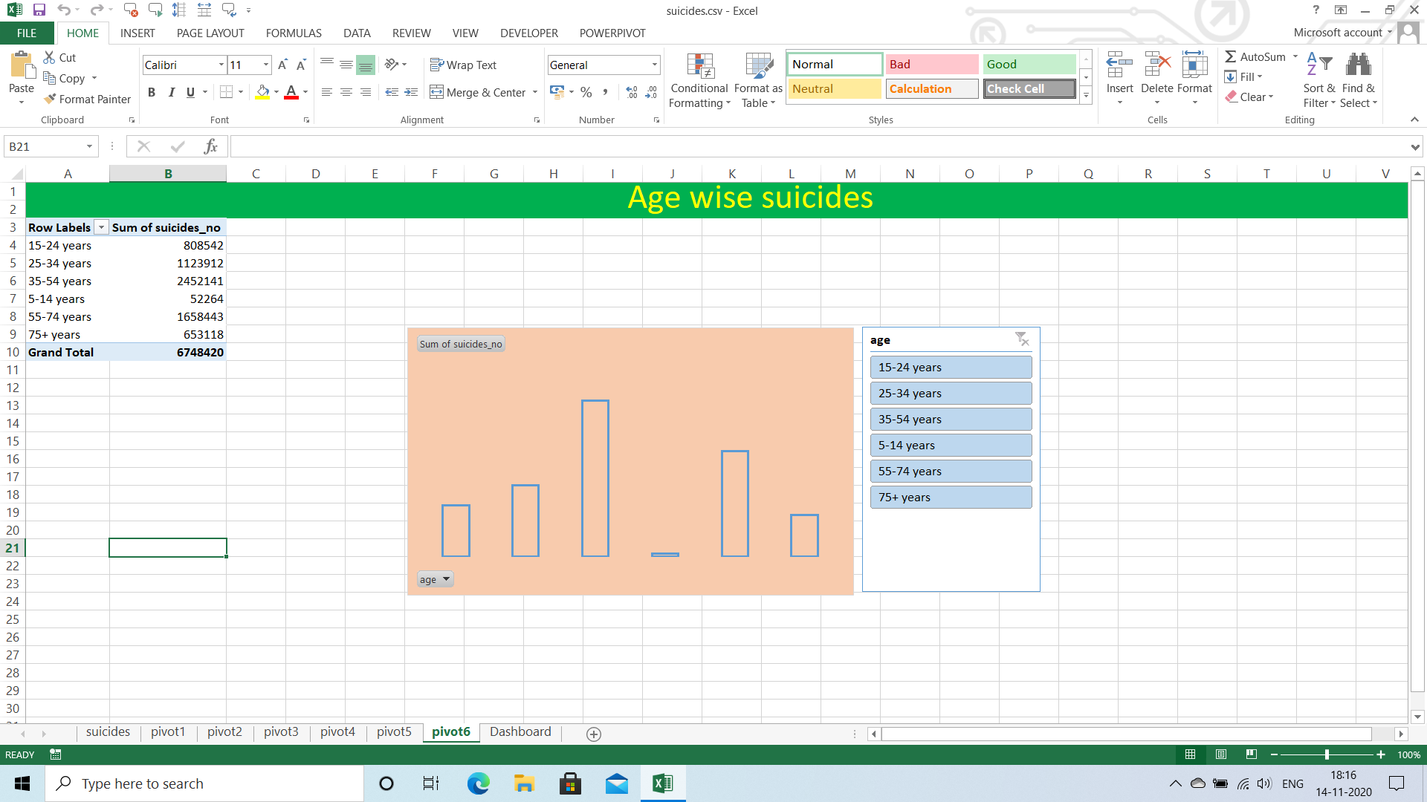
Pivot tables , charts and slicers for objectives

Slide 15
How to link a slicer with all pivot tables
Although You created a slicer for each pivot table they are not linked with each other
So Creating Dashboard becomes difficult
In order to link with all pivot tables, here is the procedure
Right click on slicer -> Report connections -> Check all the boxes that You need to connect
Now slicers are connected with each other

Slide 16
How to create a Dashboard
Dashboard is group of pivot charts , slicers in a single window
Now copy the slicers and pivot charts from each pivot table and paste it in a new sheet
You can also make your Dashboard attractive by using Background image
Now you can test the slicers by choosing different data from different slicers
Now the Dashboard is completed

Slide 17
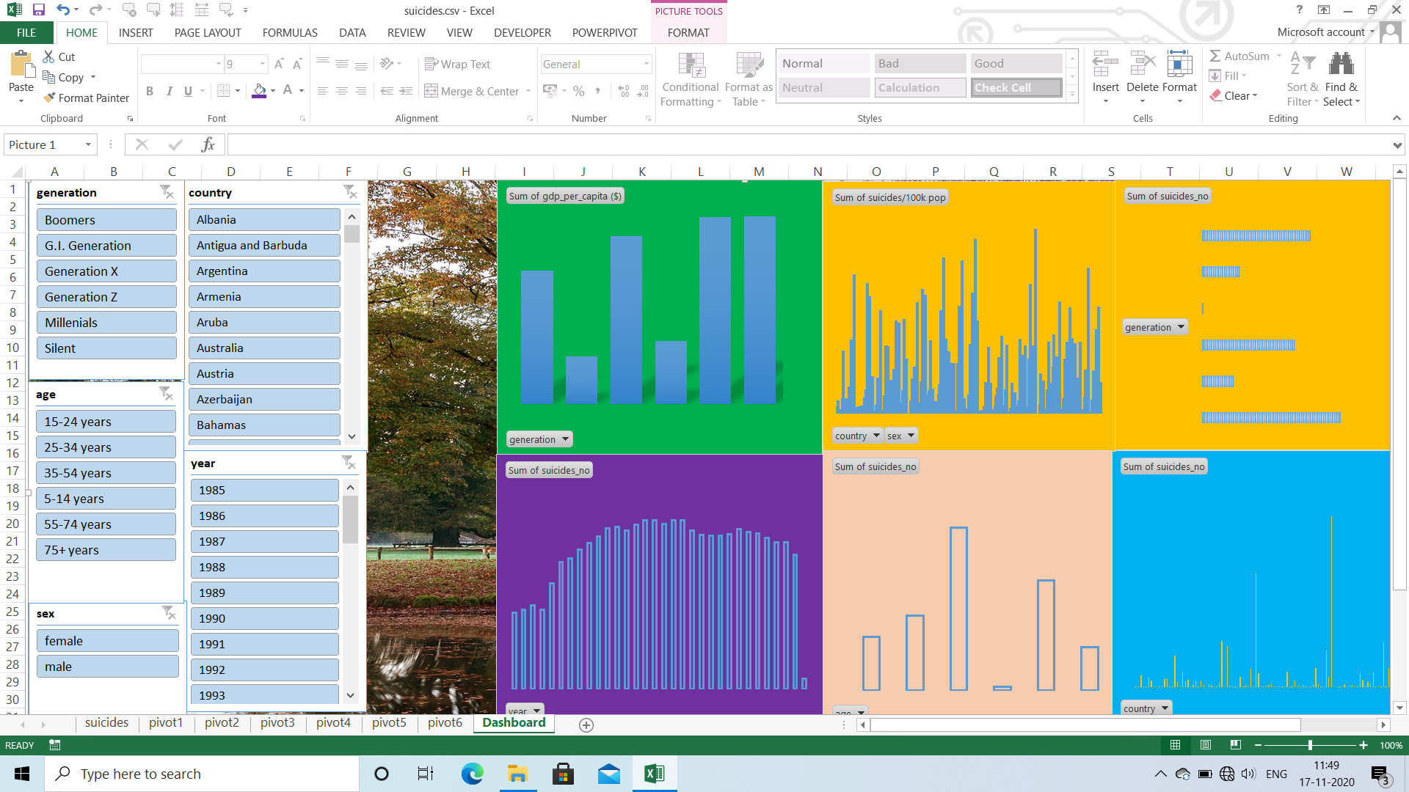

Slide 18
THANK YOU

